Slide 1
Introduction to HTML5 and CSS3: Day 4 Dr. Naveen Kumar, BES-1

Slide 2
Agenda
What is CSS
What is use of CSS?
Different Types of CSS Selectors
Different ways to use CSS
CSS Overriding Rules

Slide 3
What is CSS
Cascading Style Sheets: Design Language.
Controlling color, fonts, spacing in paragraph, background image layout design, variant devices and screen sizes etc.
It is a style Rules {Selector, Property, and value}
Ex: selector {property : value}
CSS1 in 1996
CSS2 in 1998

Slide 4
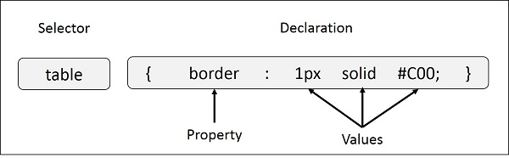
Example: Single Property
selector { property: value }
table{ border :1px solid #C00; }
CSS Comments /*….*/

Slide 5
Example: Multiple Properties
h1 {
color: #36C;
font-weight: normal;
letter-spacing: .4em;
margin-bottom: 1em;
text-transform: lowercase;
}

Slide 6
Use of CSS
CSS Saves Time
Pages load faster
Easy maintenance
Superior styles to HTML
Multiple Device Compatibility
Global Web Standards

Slide 7
Different types of Selectors
HTML elements
Universal selector
Descendant Selector
Class selector
ID selector
Child selector
Attribute Selector

Slide 8
Attributes Selectors
p[lang] − Selects all paragraph elements with a lang attribute.
p[lang="fr"] − Selects all paragraph elements whose lang attribute has a value of exactly "fr".
p[lang~="fr"] − Selects all paragraph elements whose lang attribute contains the word "fr".
p[lang|="en"] − Selects all paragraph elements whose lang attribute contains values that are exactly "en", or begin with "en-".

Slide 9
Grouping Selectors
h1, h2, h3 {
color: #36C;
font-weight: normal;
letter-spacing: .4em;
margin-bottom: 1em;
text-transform: lowercase;
}
#content, #footer, #supplement {
position: absolute;
left: 510px;
width: 200px;
}

Slide 10
Different Ways to Use CSS
Inline CSS
Style attribute
Embedded CSS
Style element in head section
External CSS
link element to link .css file
Imported CSS
@import .css file as url

Slide 12
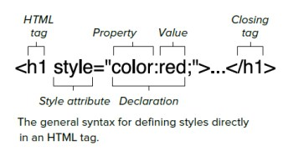
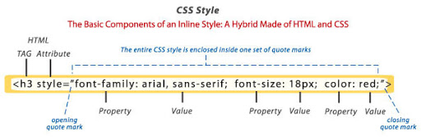
Inline CSS: Style Attribute

Slide 13
The Style Attribute (cont.)
<tagname style="property:value;">
Background Color
<p style="background-color:powderblue;">…</p>
Set background color for two different elements:
Text Color
<h1 style="color:blue;">This is a heading</h1> <p style="color:red;">This is a paragraph.</p>
Fonts
<h1 style="font-family:verdana;">This is a heading</h1> <p style="font-family:courier;">This is a paragraph.</p>

Slide 14
The Style Attribute (cont.)
Text Size
<h1 style="font-size:300%;">This is a heading</h1> <p style="font-size:160%;">This is a paragraph.</p>
Text Alignment
<h1 style="text-align:center;">Centered Heading</h1> <p style="text-align:center;">Centered paragraph.</p>

Slide 15
Style Summary
Use the style attribute for styling HTML elements
Use background-color for background color
Use color for text colors
Use font-family for text fonts
Use font-size for text sizes
Use text-align for text alignment

Slide 16
CSS Overriding Rules
Any inline style sheet takes highest priority. So, it will override any rule defined in <style>...</style> tags or rules defined in any external style sheet file.
Any rule defined in <style>...</style> tags will override rules defined in any external style sheet file.
Any rule defined in external style sheet file takes lowest priority, and rules defined in this file will be applied only when above two rules are not applicable.

Slide 17
Image in HTML

Slide 18
List and Table
Unordered List
Ordered List

Slide 19
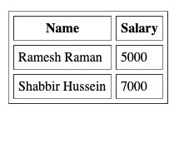
Table in HTML
Cellpadding and Cellspacing Attributes
<table border = "1" cellpadding = "5" cellspacing = "5">

Slide 20
Colspan and Rowspan Attributes
Table backgrounds
Bdcolor
background
<table border = "1" bordercolor = "green" bgcolor = "yellow">
Table Height and Width

Slide 21
Table Caption
<table <caption>This is the caption</caption></table>
Table Header, Body, and Footer
<thead> <tr> <td colspan = "4">This is the head of the table</td> </tr> </thead> <tfoot> <tr> <td colspan = "4">This is the foot of the table</td> </tr> </tfoot>

Slide 22
Nested Tables

Slide 23
Thank you

